Slide 1
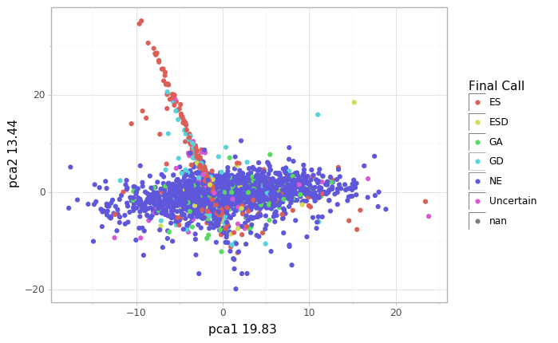
Gene clustering-PCA-LFC

Slide 2
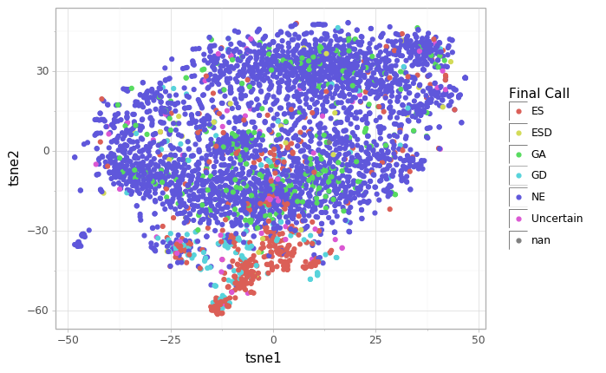
Gene clustering-tSNE-LFC

Slide 3
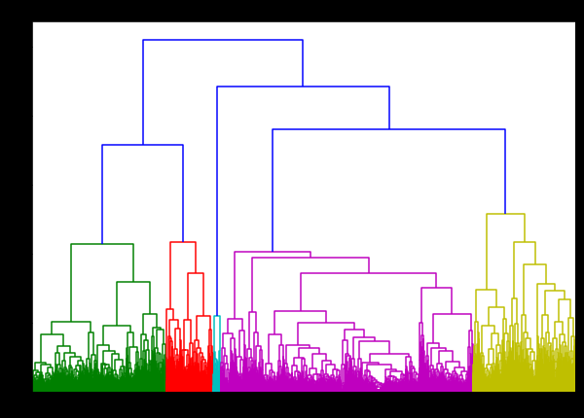
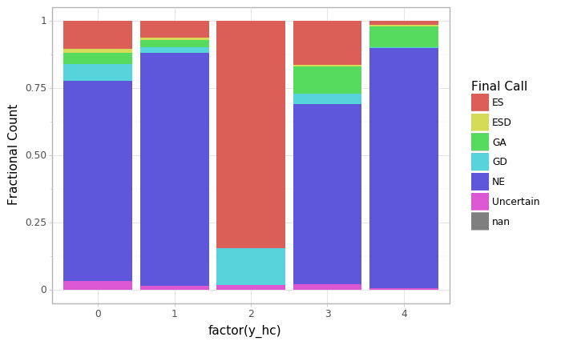
Gene clustering-hierarchical-lfc
I followed this with agglomerative clustering into 5 categories. results in
mtb_tn_db\ml-standardised_data\results\clustering_lfc_genes.csv under column y_hc. You see from the graph on the right that essential genes are in cluster 2. But I can’t find any other patterns

Slide 4
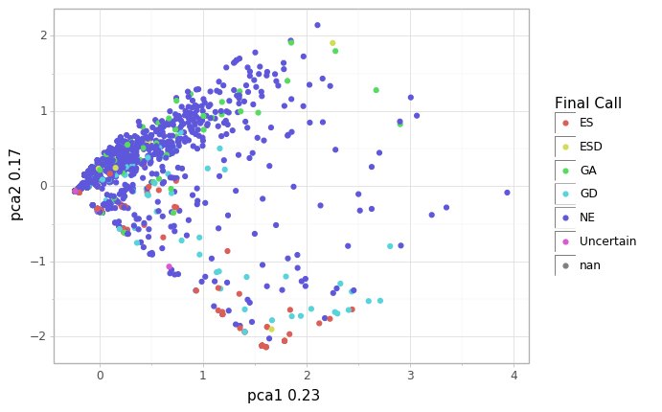
Gene clustering-PCA-Binary

Slide 5
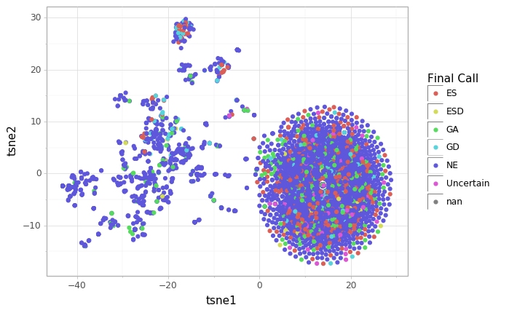
Gene clustering-tSNE-Binary
!!!! So I recolored these with ‘all zeros’, separating the rows in which genes are 0 in all conditions—see next slide

Slide 6
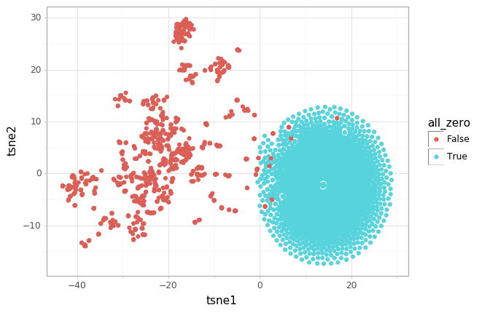
I think the binary data is very low signal. Because so many have zeros in all.

Slide 7
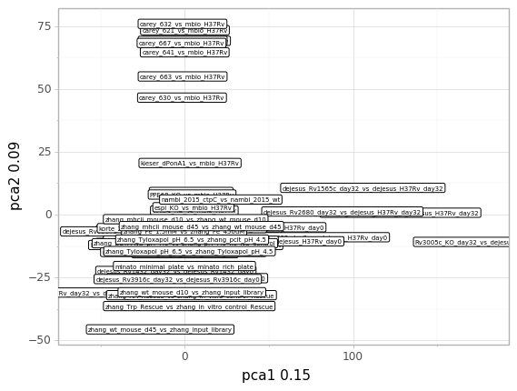
What about clustering datasets? PCA-lfc. I replaced points with labels

Slide 8
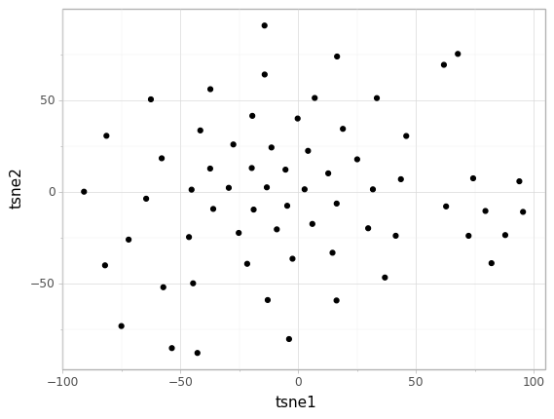
datasets-tsne-lfc

Slide 9
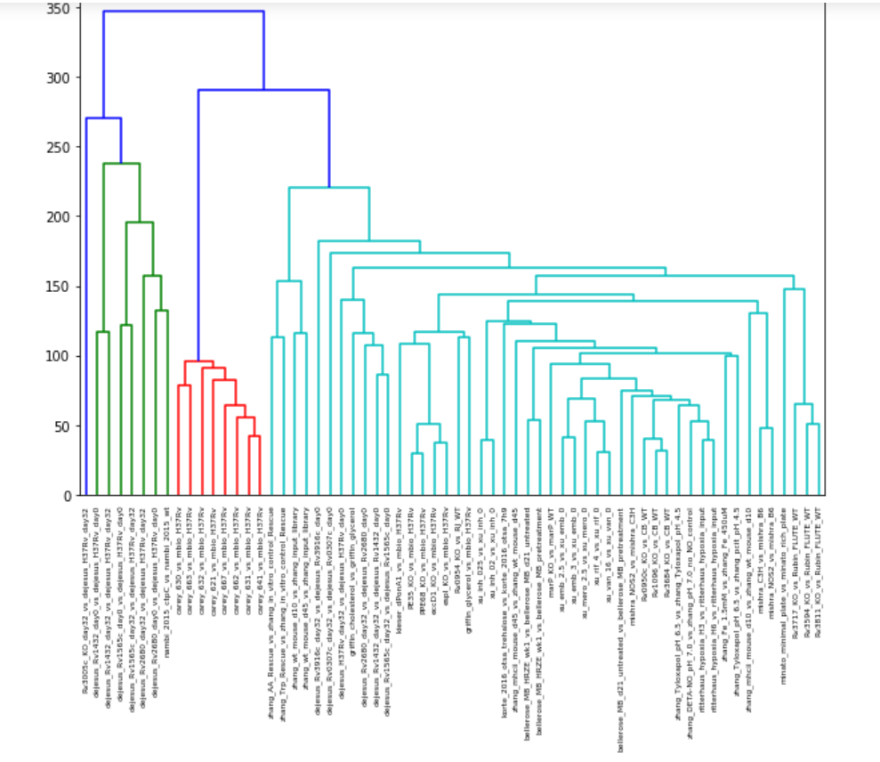
datasets-hierarchical clustering
Sorry for bad res, basically I think the careys cluster and the GG interactions do, but based on Adrian’s data I think this is because there’s something wrong with the standardization

